Slide 1
Detailed Poisson Solution and Band Diagram of Cylindrical Bandgap-Engineered SONOS Structure

Slide 2
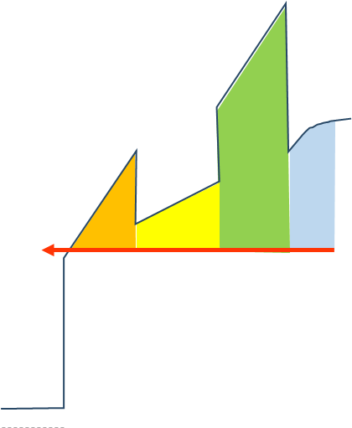
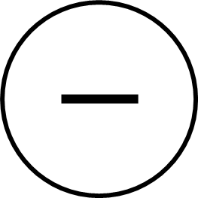


Detrapping from CTN
CTN
Same Implementation!
Vertical Partition Method
=> Non-uniform field!
$e_{n, CTN }$
$E_{Fi}$
More detailed Poisson for non-uniform trap distribution band diagram is needed.

Slide 3
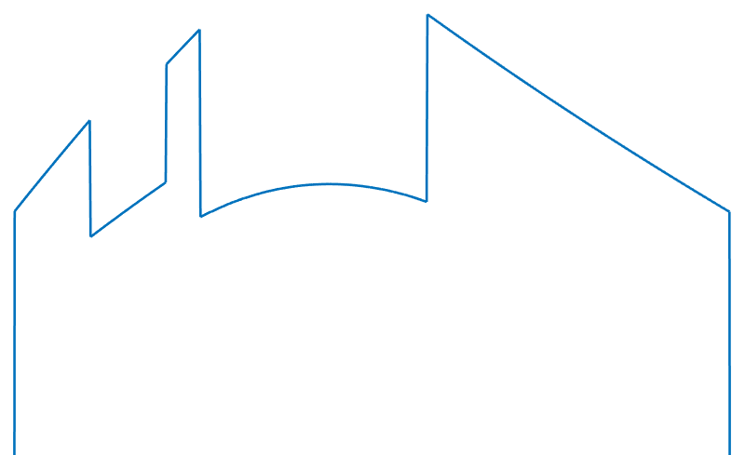
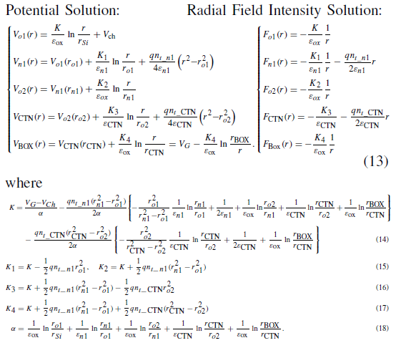
CTN Model Poisson in Partitions
Original Method: only a block of uniformly distributed trap model
New Method: Partitioned CTN model
Detailed Poisson Solution needed!

Slide 4

Detailed Poisson Solution
Used Poisson equation
$V_{o1}\left(r\right)=\frac{K_{o1}}{ε_{o1}}\ln{\frac{r}{r_{Si}}}$
$V_{n1}\left(r\right)=\frac{K_{o1}}{ε_{o1}}\ln{\frac{r_{o1}}{r_{Si}}}+\frac{K_{n1}}{ε_{n1}}\ln{\frac{r}{r_{o1}}}+\frac{qn_{t_n1}}{4ε_{n1}} \left(r^{2}−r_{o1}^{2}\right)$
$V_{o2}\left(r\right)=V_{n1}\left(r_{n1}\right)+\frac{K_{o2}}{ε_{ox}}\ln{\frac{r}{r_{n1}}}$
i = 1
$V_{CTN,1}\left(r\right)=V_{o2}\left(r_{o2}\right)+\frac{K_{CTN,1}}{ε_{CTN}}\ln{\frac{r}{r_{o2}}}+\frac{qn_{t_CTN,1}}{4ε_{CTN}}\left(r^{2}−r_{o2}^{2}\right)$
i = 2 ~ N
$V_{CTN,i}\left(r\right)=V_{CTN,i−1}\left(r_{CTN,i−1}\right)+\frac{K_{CTN,i}}{ε_{CTN}}\ln{\frac{r}{r_{tox}}}+\frac{qn_{t_CTN,i}}{4ε_{CTN}}\left(r^{2}−r_{CTN,i−1}^{2}\right)$
$V_{BOX}\left(r\right)=V_{CTN,N}\left(r_{CTN,N}\right)+\frac{K_{BOX}}{ε_{BOX}}\ln{\frac{r}{r_{CTN,N}}}$
CTN Partition in N

Slide 5



Detailed Poisson Solution
Boundary Conditions
r = r_{o1}
$K_{o1}=K_{n1}+\frac{1}{2}qn_{t_n1}r_{o1}^{2}$
r = r_{n1}
$K_{n1}+\frac{1}{2}qn_{t_n1}r_{o1}^{2}=K_{o2}$
r = r_{o2}
$K_{o2}=K_{CTN,1}+\frac{1}{2}qn_{t_CTN,1}r_{o2}^{2}$
$K_{CTN,i−1}+\frac{1}{2}qn_{t_CTN,i−1}r_{CTN,i−1}^{2}=K_{CTN,i}+\frac{1}{2}qn_{t_CTN,i}r_{CTN,i−1}^{2}$
r = r_{CTN,i-1}
r = r_{CTN,N}
$K_{CTN,N}+\frac{1}{2}qn_{t_CTN,N}r_{CTN,N}^{2}=K_{BOX}$
Unknowns: K_{o1}, K_{n1}, K_{o2}, K_{CTN,1~N} , K_{BOX}
Above equations: r_{o1}, r_{n1}, r_{o2}, r_{CTN,1~N}
One more BC needed

Slide 6

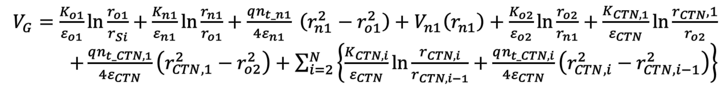
Detailed Poisson Solution
Boundary Condition : Gate Voltage
$V_{BOX}\left(r\right)=V_{CTN,N}\left(r_{CTN,N}\right)+\frac{K_{BOX}}{ε_{BOX}}\ln{\frac{r}{r_{CTN,N}}}$
$r= r_{BOX}$
$V_{BOX}\left(r_{BOX}\right)=V_{CTN,N}\left(r_{CTN,N}\right)+\frac{K_{BOX}}{ε_{BOX}}\ln{\frac{r_{BOX}}{r_{CTN,N}}}=V_{G}$
in result,
$V_{G}=\frac{K_{o1}}{ε_{o1}}\ln{\frac{r_{o1}}{r_{Si}}}+\frac{K_{n1}}{ε_{n1}}\ln{\frac{r_{n1}}{r_{o1}}}+\frac{qn_{t_n1}}{4ε_{n1}} \left(r_{n1}^{2}−r_{o1}^{2}\right)+V_{n1}\left(r_{n1}\right)+\frac{K_{o2}}{ε_{o2}}\ln{\frac{r_{o2}}{r_{n1}}}+\frac{K_{CTN,1}}{ε_{CTN}}\ln{\frac{r_{CTN},1}{r_{o2}}}$ $+\frac{qn_{t_CTN,1}}{4ε_{CTN}}\left(r_{CTN,1}^{2}−r_{o2}^{2}\right)+\sum_{i=2}^{N}{\left\{\frac{K_{CTN,i}}{ε_{CTN}}\ln{\frac{r_{CTN,i}}{r_{CTN,i−1}}}+\frac{qn_{t_CTN,i}}{4ε_{CTN}}\left(r_{CTN,i}^{2}−r_{CTN,i−1}^{2}\right)\right\}}$
Now, unknowns can be solved

Slide 7
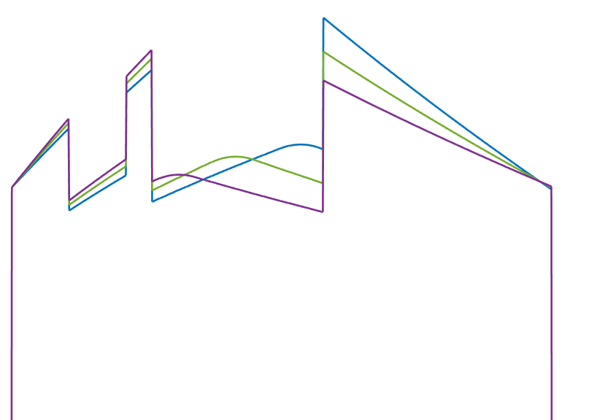
Poisson Solution Variations
Si
BETOX
CTN
BOX
WL
Si
BETOX
CTN
BOX
WL
Si
BETOX
CTN
BOX
WL
o1
n1
o2
o1
n1
o2
o1
n1
o2
$$r_{Si}$$
$$r_{o1}$$
$$r_{n1}$$
$$r_{o2}$$
$$r_{ctn}$$
$$r_{box}$$
$$r$$
$$r_{Si}$$
$$r_{o1}$$
$$r_{n1}$$
$$r_{o2}$$
$$r_{ctn}$$
$$r_{box}$$
$$r$$
$$r_{Si}$$
$$r_{o1}$$
$$r_{n1}$$
$$r_{o2}$$
$$r_{ctn}$$
$$r_{box}$$
$$r$$
-qn_{t_n1}
-qn_{t_n1}
-qn_{t_n1}
$$t_{o1}$$
$$t_{n1}$$
$$t_{o2}$$
$$t_{ctn}$$
$$t_{box}$$
$$t_{o1}$$
$$t_{n1}$$
$$t_{o2}$$
$$t_{ctn}$$
$$t_{box}$$
$$t_{o1}$$
$$t_{n1}$$
$$t_{o2}$$
$$t_{ctn}$$
$$t_{box}$$
Variations of trap distributions also can be discussed

Slide 8
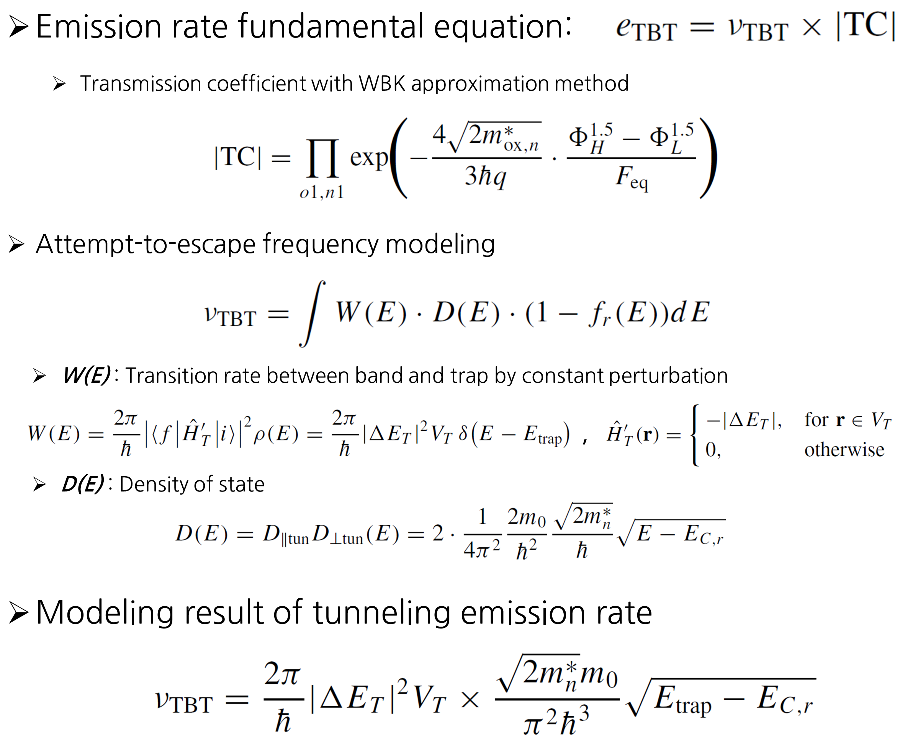
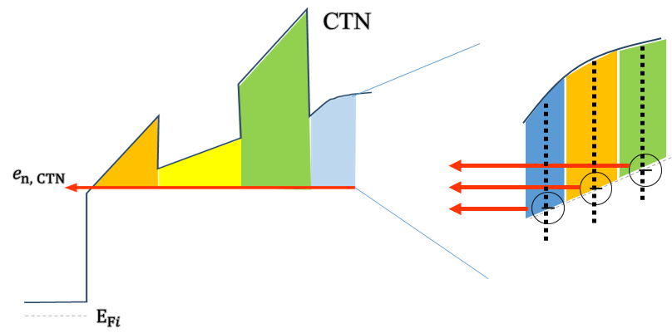
Future Works
BETOX Detrapping Summary
BE-TOX (ONO)
o1 layer
n1 layer
o2 layer
CTN
Si-channel
(reservoir)
TC_{n1}
|ΔE_{T}|
E_{trap}
E_{C,r}
E_{trap} > E_{C,r}
For emission
TC_{o1}
CTN Detrapping Emission Modeling based on Detailed Poisson Solution

